Slide 1
Semantic Information Modeling for Federation
SIMF
Cory Casanave

Slide 2
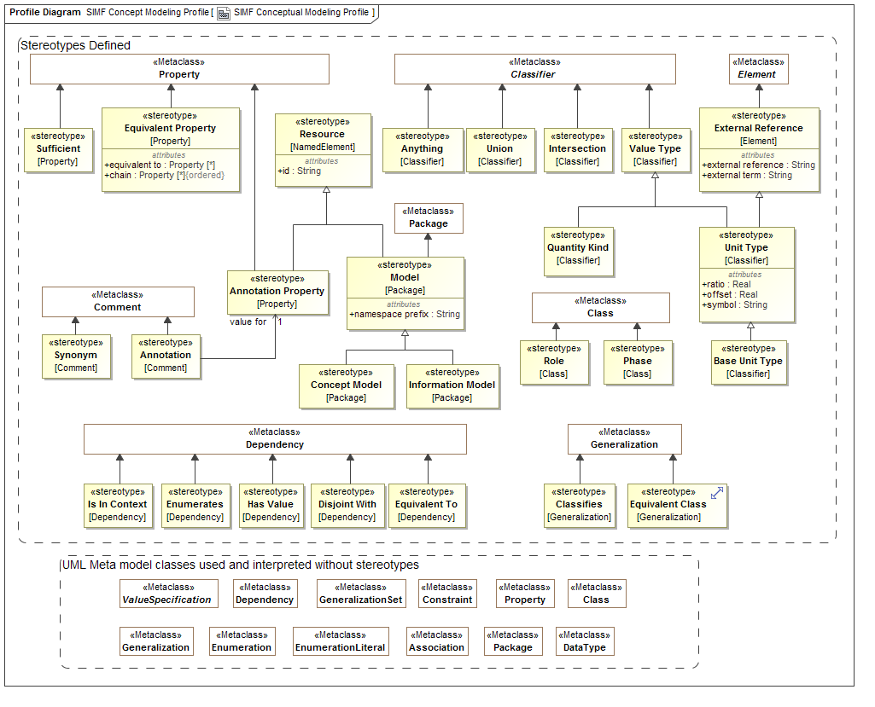
Conceptual Model Profile

Slide 3
SIMF Conceptual Modeling Profile
Jim Logan

Slide 4
Overview
Uses “normal” UML with business-facing terms
Takes advantage of a few “loose” areas of UML
Unnamed redefining properties
Unnamed subsetting properties
Adds some extensions (next slide)

Slide 5
Extension to UML
Class extensions:
«Anything»
«Union»
«Intersection»
«Equivalent Class»
«Role»
«Phase»
Comment extension: «Annotation» {annotation property = annotation property}
Property extensions:
«Annotation Property»
«Equivalent Property»
{equivalent property = property}
{chain = property, property}
«Sufficient»
«Value Type»
«Facet Of» (Examples still say «Classifies»)

Slide 6
Simple Classes and Properties (Model)

Slide 7
Simple Classes and Properties (MM Instances)

Slide 8
Simple Classes and Properties (OWL)
Ontology(<http://example.com/SIMF/Company>
Declaration(Class(:Employee))
Declaration(Class(:Employer))
Declaration(ObjectProperty(:employedBy))
Declaration(ObjectProperty(:employs))
SubClassOf(:Employee ObjectIntersectionOf(
ObjectMaxCardinality(1 :employedBy :Employer)
ObjectMinCardinality(1 :employedBy :Employer))
)
InverseObjectProperties(:employedBy :employs)
ObjectPropertyDomain(:employedBy :Employee)
ObjectPropertyRange(:employedBy :Employer)
ObjectPropertyDomain(:employs :Employer)
ObjectPropertyRange(:employs :Employee)
AnnotationAssertion(rdfs:label :Employee "Employee"@en)
AnnotationAssertion(rdfs:label :Employer "Employer"@en)
AnnotationAssertion(rdfs:label :employedBy "employed by"@en)
AnnotationAssertion(rdfs:label :employs "employs"@en)
)
Prefixes elided for readability.
Will elide most annotations for remaining slides.

Slide 9
Global Properties (Model)

Slide 10
Global Properties (MM Instances)

Slide 11
Global Properties (OWL)
Ontology(<http://example.com/SIMF/Relations>
Import(<http://example.com/SIMF/DutiesAndResponsibilities#>)
Declaration(Class(<http://example.com/SIMF/DutiesAndResponsibilities#Duty>))
Declaration(ObjectProperty(:hasResponsibility))
Declaration(ObjectProperty(:isConferredBy))
Declaration(ObjectProperty(:isConferredOn))
ObjectPropertyRange(:hasResponsibility
<http://example.com/SIMF/DutiesAndResponsibilities#Duty>)
)

Slide 12
Incomplete and Disjoint (Model)

Slide 13
Incomplete and Disjoint (MM Instances)

Slide 14
Incomplete and Disjoint (OWL)
Ontology(<http://example.com/ontology/Animals>
Declaration(Class(:Animal))
Declaration(Class(:Cat))
Declaration(Class(:Dog))
SubClassOf(:Cat :Animal)
DisjointClasses(:Cat :Dog)
SubClassOf(:Dog :Animal)
)

Slide 15
Incomplete and Overlapping (Model)

Slide 16
Incomplete and Overlapping (MM Instances)

Slide 17
Incomplete and Overlapping (OWL)
Ontology(<http://example.com/SIMF/Manufacturer1>
Declaration(Class(:CarManufacturer))
Declaration(Class(:Manufacturer))
Declaration(Class(:WindshieldManufacturer))
SubClassOf(:CarManufacturer :Manufacturer)
SubClassOf(:WindshieldManufacturer :Manufacturer)
)

Slide 18
Complete and Disjoint (Model)

Slide 19
Complete and Disjoint (MM Instances)

Slide 20
Complete and Disjoint (OWL)
Ontology(<http://example.com/SIMF/Manufacturer2>
Declaration(Class(:CarManufacturer))
Declaration(Class(:Manufacturer))
Declaration(Class(:WindshieldManufacturer))
DisjointClasses(:CarManufacturer :WindshieldManufacturer)
SubClassOf(:CarManufacturer :Manufacturer)
SubClassOf(:WindshieldManufacturer :Manufacturer)
EquivalentClasses(:Manufacturer ObjectUnionOf(:WindshieldManufacturer :CarManufacturer))
)

Slide 21
Universal Quantification (Model)

Slide 22
Universal Quantification (MM Instances)

Slide 23
Universal Quantification (OWL)
Ontology(<http://example.com/SIMF/Pets>
Declaration(Class(:Dog))
Declaration(Class(:DogOwner))
Declaration(Class(:Person))
Declaration(Class(:Pet))
Declaration(ObjectProperty(:has))
SubClassOf(:Dog :Pet)
SubClassOf(:DogOwner :Person)
EquivalentClasses(
:DogOwner
ObjectIntersectionOf(
ObjectMinCardinality(1 :has :Dog) ObjectAllValuesFrom(:has :Dog)
)
)
ObjectPropertyDomain(:has :Person)
ObjectPropertyRange(:has :Pet)
)

Slide 24
Existential Quantification and Union (Model)

Slide 25
Existential Quantification and Union (MM Instances)

Slide 26
Subproperties (Model)

Slide 27
Subproperties (MM Instances)

Slide 28
Existential Quantification, Union, and Subproperties (OWL)
Ontology(<http://example.com/SIMF/LegalCapacities>
Import(<http://example.com/SIMF/Agents#>)
Import(<http://example.com/SIMF/Relations#>)
Import(<http://example.com/SIMF/LegalCore#>)
Import(<http://example.com/SIMF/Contracts#>)
Declaration(Class(:LegalCapacity))
Declaration(Class(:LegalConstruct))
SubClassOf(:LegalCapacity
ObjectMinCardinality(1 :isCapacityOf
<http://example.com/SIMF/Agents#AutonomousAgent>
)
)
SubClassOf(:LegalConstruct
ObjectSomeValuesFrom(
<http://example.com/SIMF/Relations#isConferredBy>
ObjectUnionOf(
<http://example.com/SIMF/Contracts#Contract>
<http://example.com/SIMF/LegalCore#Constitution>
<http://example.com/SIMF/LegalCore#Law>
)
)
)
Declaration(ObjectProperty(<http://example.com/SIMF/Agents#hasCapacity>))
Declaration(ObjectProperty(<http://example.com/SIMF/Relations#isConferredBy>))
Declaration(ObjectProperty(<http://example.com/SIMF/Relations#isConferredOn>))
Declaration(ObjectProperty(:isCapacityOf))
InverseObjectProperties(<http://example.com/SIMF/Agents#hasCapacity> :isCapacityOf)
SubObjectPropertyOf(:isCapacityOf <http://example.com/SIMF/Relations#isConferredOn>)
ObjectPropertyDomain(:isCapacityOf :LegalCapacity)
ObjectPropertyRange(:isCapacityOf <http://example.com/SIMF/Agents#AutonomousAgent>)
)

Slide 29
Annotation Properties and Annotations (Model)

Slide 30
Annotation Properties and Annotations (MM Instances)

Slide 31
Annotation Properties and Annotations (OWL)
Ontology(<http://example.com/ontology/Library>
Declaration(Class(:Book))
Declaration(Class(:LibraryBranch))
Declaration(Class(:Periodical))
Declaration(ObjectProperty(:lends))
Declaration(ObjectProperty(:lentBy))
SubClassOf(:LibraryBranch
ObjectMinCardinality(1 :lends ObjectUnionOf(:Periodical :Book)))
Declaration(AnnotationProperty(:description))
Declaration(AnnotationProperty(:branchEntryDate))
AnnotationPropertyDomain(:branchEntryDate :LibraryBranch)
AnnotationPropertyRange(:branchEntryDate xsd:date)
InverseObjectProperties(:lends :lentBy)
ObjectPropertyDomain(:lends :LibraryBranch)
ObjectPropertyRange(:lends ObjectUnionOf(:Periodical :Book))
ObjectPropertyDomain(:lentBy ObjectUnionOf(:Periodical :Book))
ObjectPropertyRange(:lentBy :LibraryBranch)
AnnotationAssertion(:description :LibraryBranch
"A building where Books or Periodicals may be read or borrowed."@en)
)

Slide 32
Association Class and Roles (Model)

Slide 33
Association Class and Roles (MM Instances)

Slide 34
Association Class and Roles (OWL)
Ontology(<http://example.com/SIMF/AssnClassOWLReification>
Declaration(Class(:Control))
Declaration(Class(:ControlledEntity))
Declaration(Class(:ControllingActor))
Declaration(Class(:Entity))
Declaration(Class(:Resource))
Declaration(Class(:ResponsiblePerformer))
Declaration(Class(:Role))
Declaration(Class(:Situation))
Declaration(Class(:TimePoint))
Declaration(Class(:Timeframe))
SubClassOf(:Control :Situation)
SubClassOf(:ControlledEntity :Role)
SubClassOf(:ControlledEntity ObjectAllValuesFrom(:playedBy :Resource))
SubClassOf(:ControllingActor :Role)
SubClassOf(:ControllingActor ObjectAllValuesFrom(:playedBy :ResponsiblePerformer))
SubClassOf(:Resource :Entity)
SubClassOf(:Situation ObjectAllValuesFrom(:hasTimeframe :Timeframe))
Declaration(ObjectProperty(:endsOn))
Declaration(ObjectProperty(:hasControlOver))
Declaration(ObjectProperty(:hasTimeframe))
Declaration(ObjectProperty(:isControlledBy))
Declaration(ObjectProperty(:playedBy))
Declaration(ObjectProperty(:plays))
Declaration(ObjectProperty(:startsOn))
Declaration(DataProperty(:value))
Declaration(Datatype(xsd:Date))
ObjectPropertyDomain(:endsOn :Timeframe)
ObjectPropertyRange(:endsOn :TimePoint)
ObjectPropertyDomain(:hasControlOver :Control)
ObjectPropertyRange(:hasControlOver :ControlledEntity)
ObjectPropertyRange(:hasTimeframe :Timeframe)
ObjectPropertyDomain(:isControlledBy :Control)
ObjectPropertyRange(:isControlledBy :ControllingActor)
ObjectPropertyDomain(:playedBy :Role)
ObjectPropertyRange(:plays :Role)
ObjectPropertyDomain(:startsOn :Timeframe)
ObjectPropertyRange(:startsOn :TimePoint)
DataPropertyDomain(:value :TimePoint)
DataPropertyRange(:value xsd:Date)
)

Slide 35
Association Class and Roles (Profile)

